Slide 1


Team AWESOME-AOC
Autonomous Winged Educational Surveillance Operational Mission Experiment
Using inertial navigation systems (INS) to navigate
small unmanned aerial system (sUAS) when GPS is lost or inaccurate
Michael du Breuil, Alex Goodan
Team AWESOME-AOC

Slide 2
Overview
Problem
Our Research
What’s Next
Team AWESOME-AOC

Slide 3
Problem
GPS is susceptible to exterior interference
Current sUAS navigation solutions are GPS reliant
Current off the shelf INS solutions degrade quickly
Team AWESOME-AOC

Slide 4
Our Research
Evaluate off the shelf sensors
Projected accuracy rates
Error analysis
Foundation for improved INS in sUAS
Team AWESOME-AOC

Slide 5
INS Components
Accelerometer
Gyroscope
Magnetometer
Barometer
Team AWESOME-AOC

Slide 6
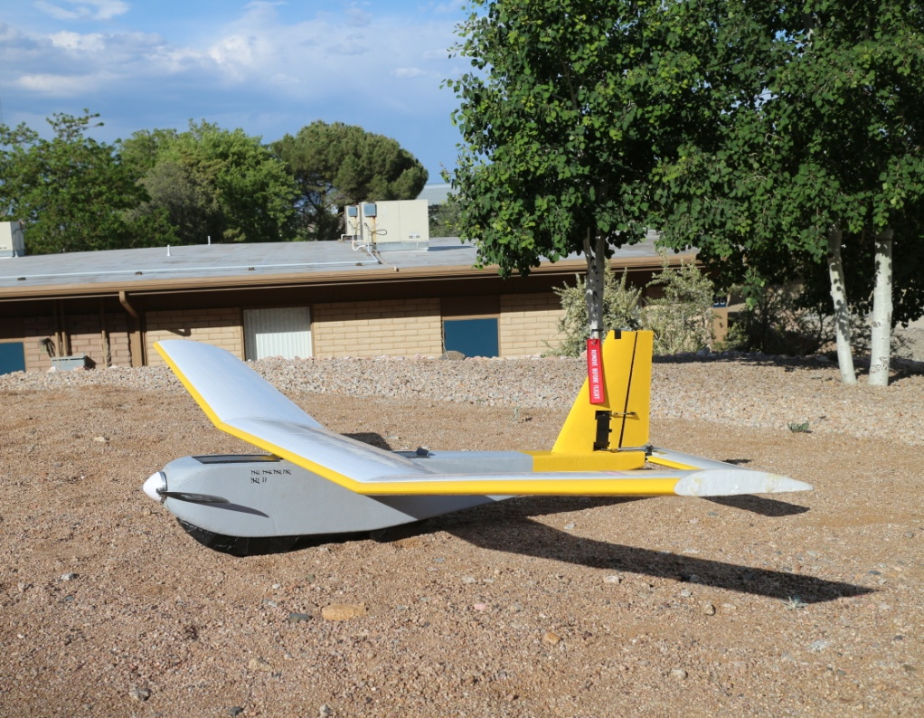
Test Platform
Custom made airframe
ArduPilot/PX4/PixHawk autopilot
BeagleBone Black
Team AWESOME-AOC

Slide 7
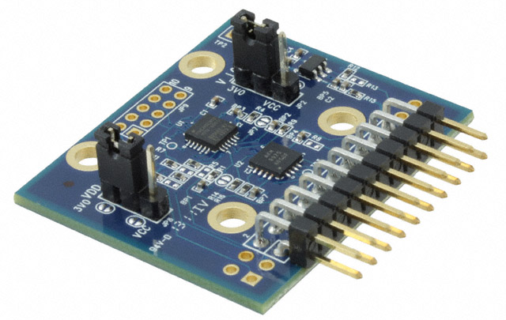
MPU-6000
Used on ArduPilot/PX4/PixHawk
Cost: $15
4x4x0.9mm
<1 gram
Team AWESOME-AOC

Slide 8
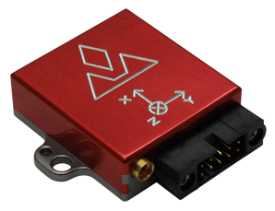
VectorNav VN-200
Low-medium performance MEMS
Cost: $2,000
36 x 34 x 9.5mm
14 grams (0.03 lbs)
Team AWESOME-AOC

Slide 9
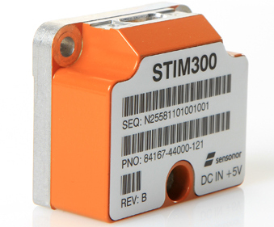
Sensonor STIM 300
High end performance MEMS
Cost: $10,000
44.8 x 38.6 x 21.5mm
55 grams (0.12 lbs)
Team AWESOME-AOC

Slide 10
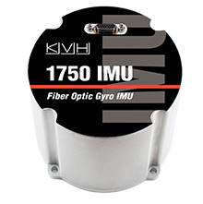
KVH 1750
High performance for size
Cost: $25,000
88.9 x 73.7 mm
600 grams (1.4 lbs)
Team AWESOME-AOC

Slide 11
IMU Error Sources
System Error
Noise
Bias
Scale Factor/ Misalignment
Bias Stability
Bias Instability
Fixed Bias
Team AWESOME-AOC

Slide 12
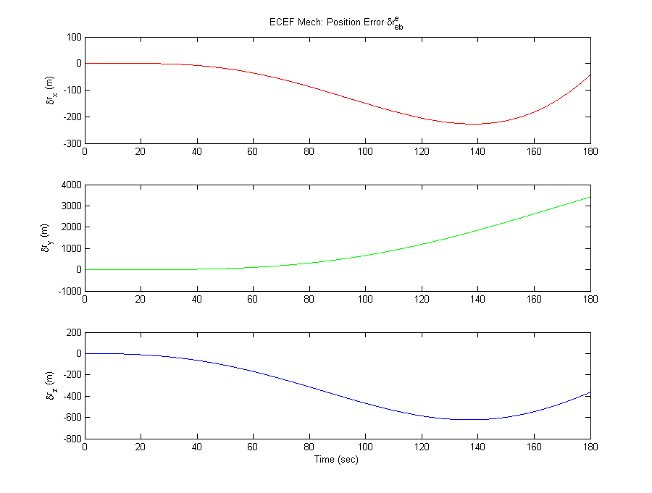
Sample Simulation (VN-200)
Team AWESOME-AOC

Slide 13
Simulated Results
Team AWESOME-AOC

Slide 14
Data Acquisition
Time stamps – Needs to be closer to the hardware
Development kit problems
Repeatability
Team AWESOME-AOC

Slide 15
What’s Next
Further simulation of sensor performance
Improve acquisition
Flight test all available sensors
Development of INS system
Team AWESOME-AOC

Slide 16
Questions?
Team AWESOME-AOC

Slide 17
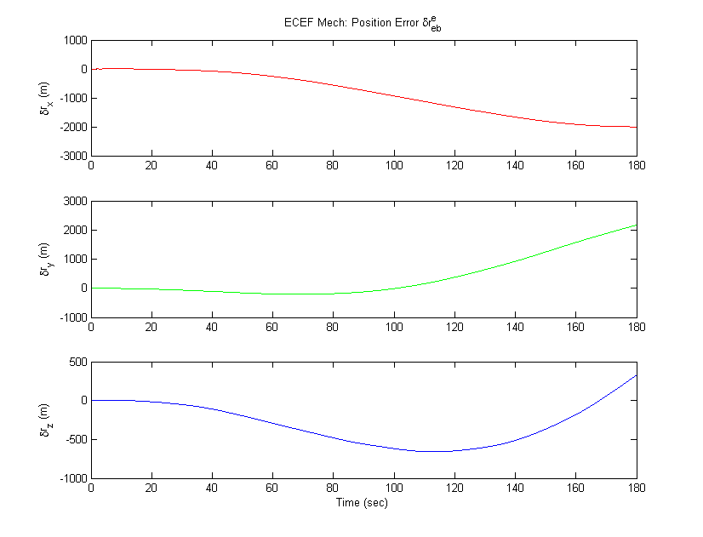
MPU-6000
Team AWESOME-AOC

Slide 18
VectorNav VN-200
Team AWESOME-AOC

Slide 19
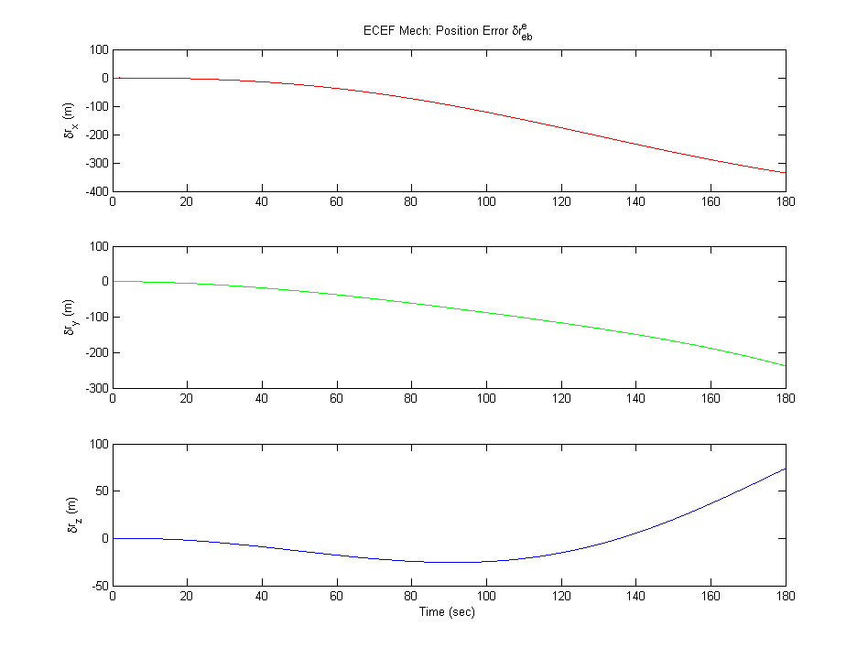
Sensonor STIM 300
Team AWESOME-AOC

Slide 20
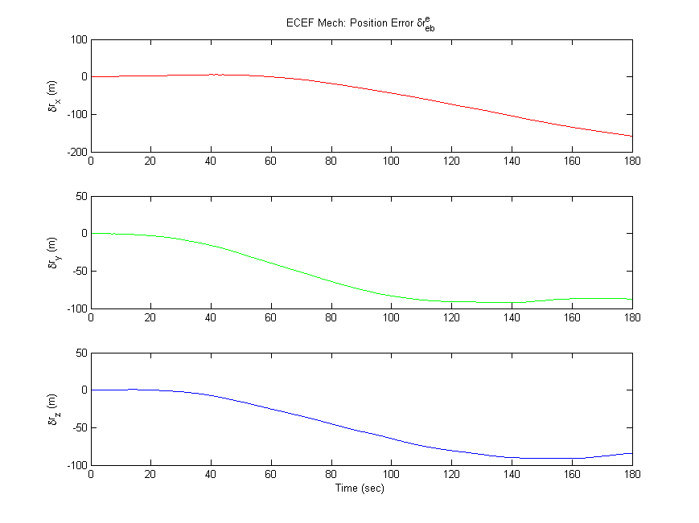
KVH 1750
Team AWESOME-AOC

Slide 21
IMU Error Sources
System Error
Noise
Bias
Scale Factor/ Misalignment
Bias Stability
Bias Instability
Fixed Bias
Team AWESOME-AOC

Slide 22
Questions?
Team AWESOME-AOC

